Slide 2
About the Assembly
A smart lab based out of In5 since Dec 2014
Over 250+ free workshops done
ASSEMBLY: HACK - Embedded systems, iOT and hardware
ASSEMBLY: CODE - Software projects - APIs, frameworks, apps
Age range: 16-60 - students, professionals, entrepreneurs
Focus on smart technology and practical applications
Forum: members.theassembly.ae

Slide 3
TAG US ON OUR SOCIAL MEDIA
FACEBOOK
TWITTER
INSTAGRAM
YOUTUBE
The Assembly (@MakeSmartThings)
@MakeSmartThings
@MakeSmartThings
The Assembly

Slide 4
Agenda
Radar System - What is it?
Real life applications
How it Works
Hardware
Circuit Image
Arduino IDE Code
Ultrasonic test code
Final Arduino code
Processing IDE
Basics
Final

Slide 5
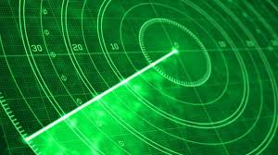
Radar System

Slide 6
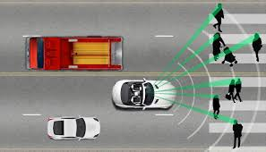
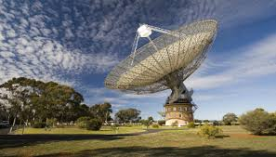
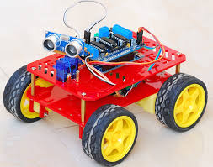
Applications

Slide 7

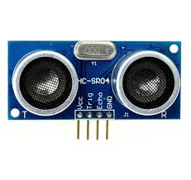

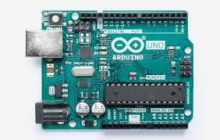
How it works?

Slide 8
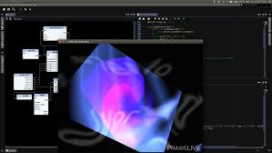
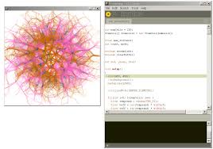
Processing IDE

Slide 9
Download Processing IDE
GitHub link –
Download and run

Slide 10
Arduino Uno
Operating Voltage: 5 Volts
Input Voltage: 7 to 20 Volts
Digital I/O Pins: 14
Analog Input Pins: 6
DC Current per I/O Pin: 20 mA
DC Current for 3.3V Pin: 50 mA

Slide 11
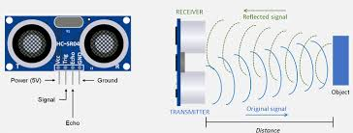
Ultrasonic Sensor

Slide 12
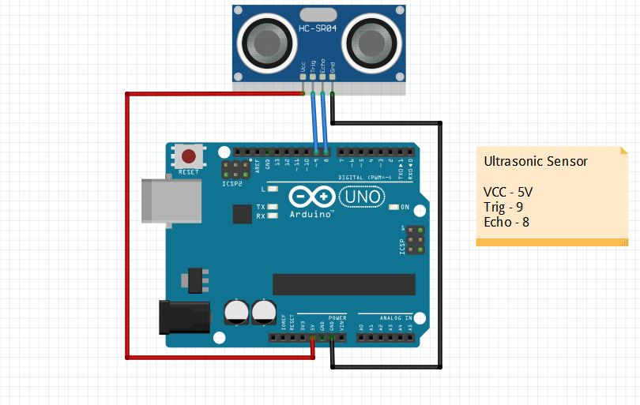
Ultrasonic Connection

Slide 13
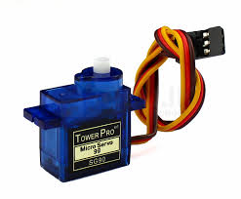
Servo Motor
allows for precise control of angular or linear position, velocity and acceleration.
Yellow – Signal
Red – 5v
Black - Ground

Slide 14
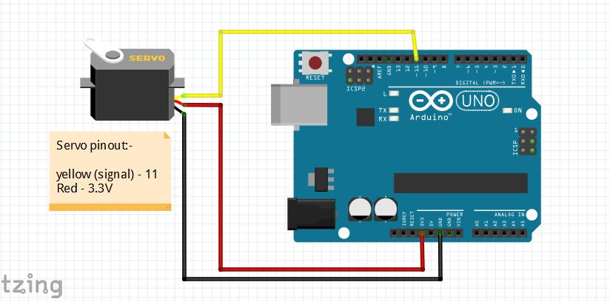
Servo Connection

Slide 15
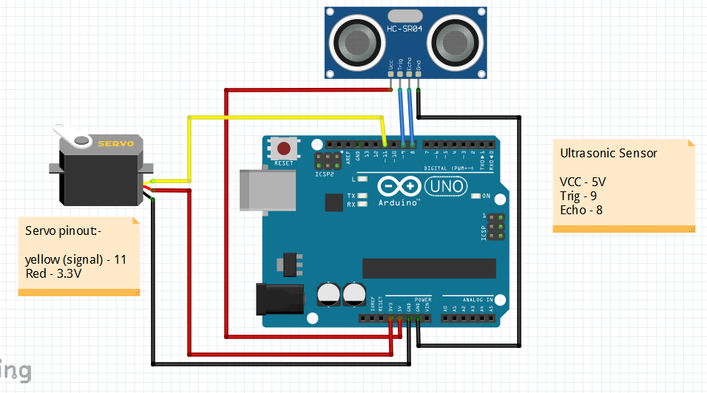
Final Circuit

